Slide 1
Singapore Travel Guide
An exercise in Clustering Singapore Neighbourhoods
- By Ashwin Mohananath Syamala

Slide 2
Business Case
There are numerous places to visit in Singapore falling under different categories that makes it hard for the average traveller to narrow down on the places that they would like to visit.
Apart from the actual venues, often travellers have to think about accommodation which is an important part of any travellers itinerary.
Travel agents and Tour operators can capitalise on this need if they can get tailored recommendations for travellers.
K-means Clustering algorithm is used for this endeavour to cluster neighbourhoods in Singapore based on the Neighbourhoods, Venue categories and the no of Airbnb listings near the venues.

Slide 3
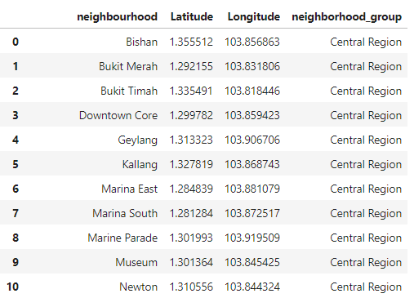
About the Data: Singapore neighbourhoods
Neighbourhood information of Singapore and the Number of Airbnb listings in each neighbourhood is available from the source Inside Airbnb (http://insideairbnb.com/get-the-data.html)
The Neighbourhood dataset has information about the Neighbourhood group, Neighbourhood name, Neighbourhood Coordinates.

Slide 4
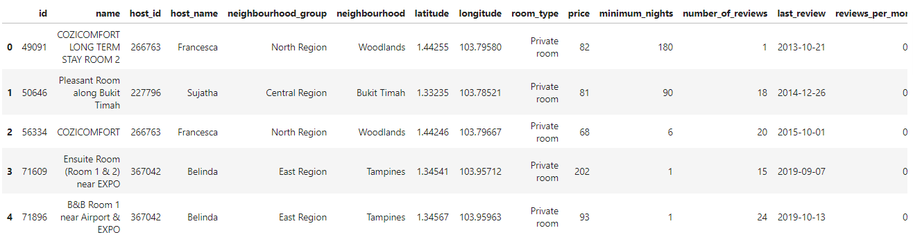
About the Data: Airbnb listings
Neighbourhood information of Singapore and the Number of Airbnb listings in each neighbourhood is available from the source Inside Airbnb (http://insideairbnb.com/get-the-data.html)
The Airbnb dataset has information about the rental properties listed in the neighbourhoods along with the coordinates of the listings.
The Airbnb dataset has also other information relating to the properties listed such as price, availability, review etc.

Slide 5
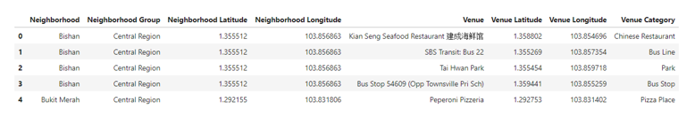
About the Data: Foursquare Data
Foursquare API calls to explore venues surrounding Singapore neighbourhoods is made and loaded into a dataframe.
Results will contain name of the venue, the venue category, and the coordinates of the venues.

Slide 6
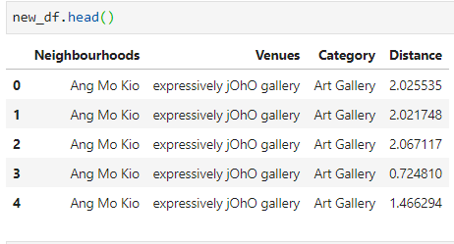
Methodology: Haversine Distance Calculation
Using the Haversine formula, distance between two geographical coordinates on earth could be found.
A custom defined function is written to loop through all the listings in the Airbnb dataset and find the distance between the coordinates of the Neighbourhood and the coordinate of the Airbnb listing.
Result is stored in a new dataframe.
Information on Haversine formula can be found in https://en.wikipedia.org/wiki/Haversine_formula

Slide 7
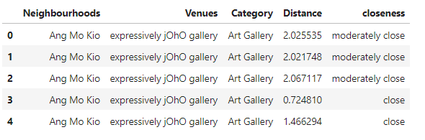
Categorising Distance into Bins
Using Cut method of Pandas Dataframes, the distance information is categorised into 3 bins.
The 3 bins are close, moderately close and far defined using the bin edges.
Distance in the range of 0 – 2 km is close, between 2 and 4 is moderately close and between 4 and 7 km is far.

Slide 8
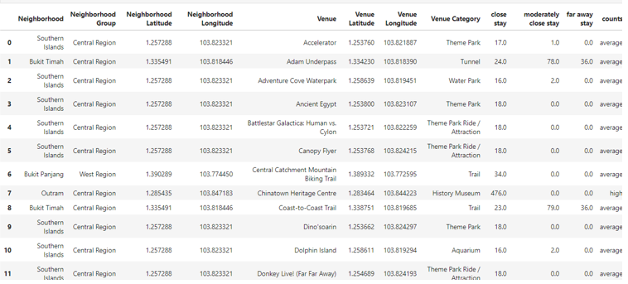
Airbnb listings count and binning
Counts of Airbnb listings in each distance category is found and added to the dataframe in similarly named columns.
Similar binning method is used to categorise the no of listings in “close stay column” as “low”, “average” or “high”
“High” means high no of listings within 2km from venue and similar interpretation for “average” and “low” categories.

Slide 9
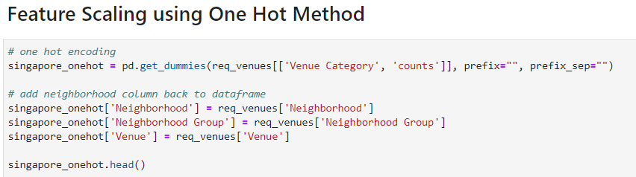
Feature Scaling: One Hot Encoding
One Hot encoding is implemented on Venues categories and the counts column from previous screenshot to convert categorical variables in 0’s and 1’s.

Slide 10
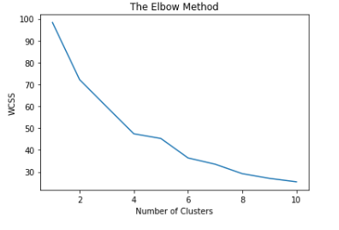
K-Means Clustering: Find Best K
Elbow Method is used to find the best value of K to run the K-means algorithm.
The best value of K is determined to be 6.

Slide 11
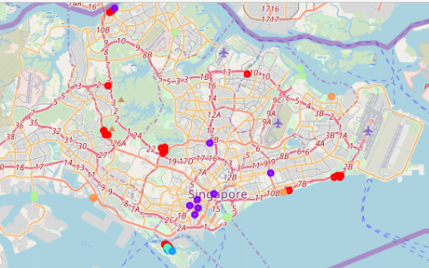
Results: Folium Map Visualisation

Slide 12
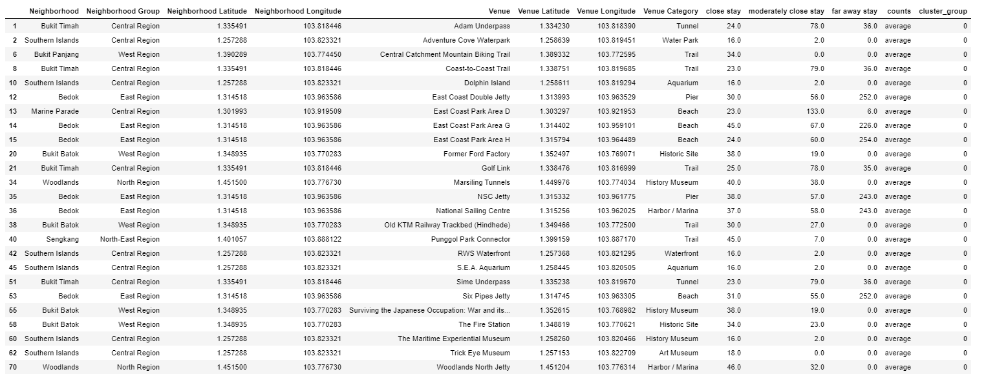
Results: Cluster 0

Slide 13
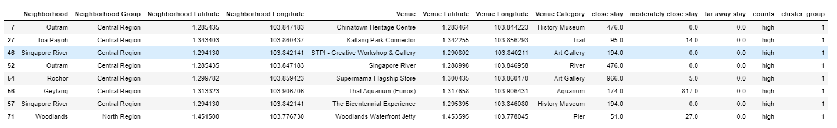
Results: Cluster 1

Slide 14
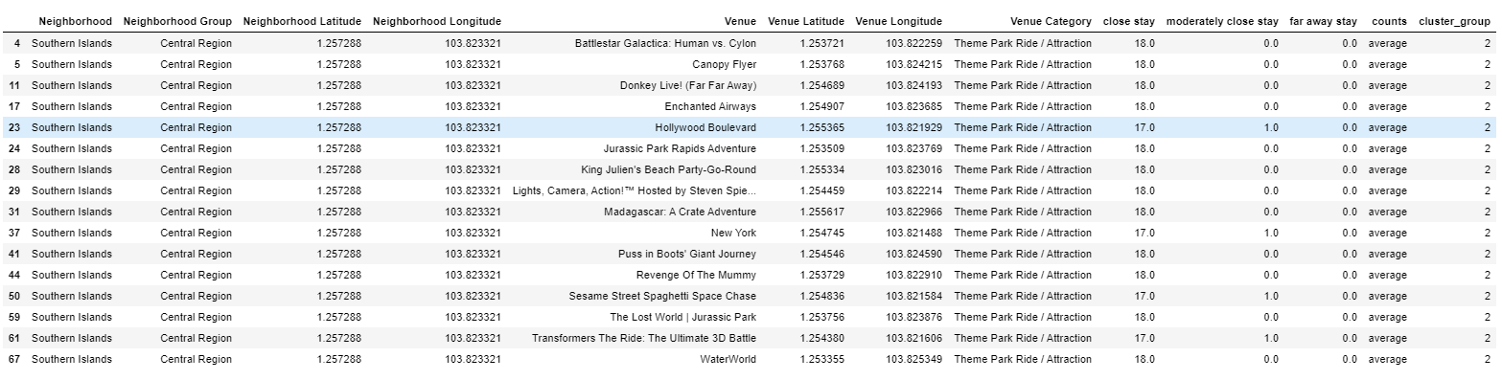
Results: Cluster 2

Slide 15
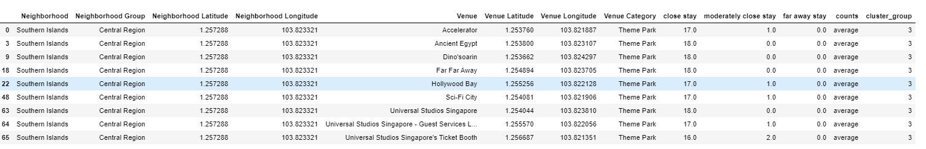
Results: Cluster 3

Slide 16
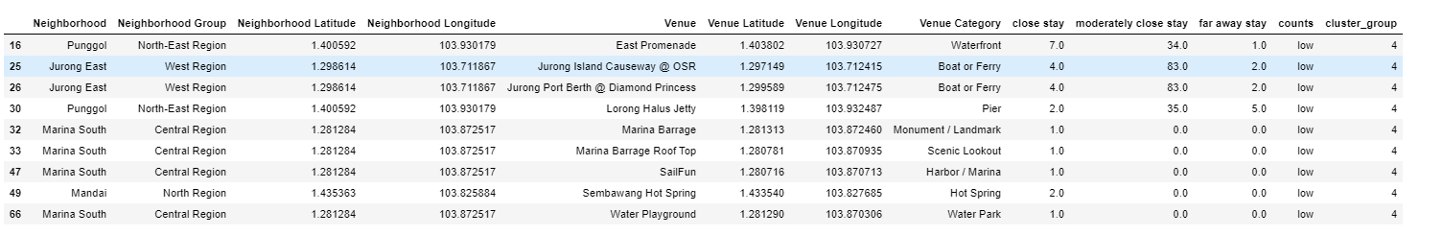
Results: Cluster 4

Slide 17
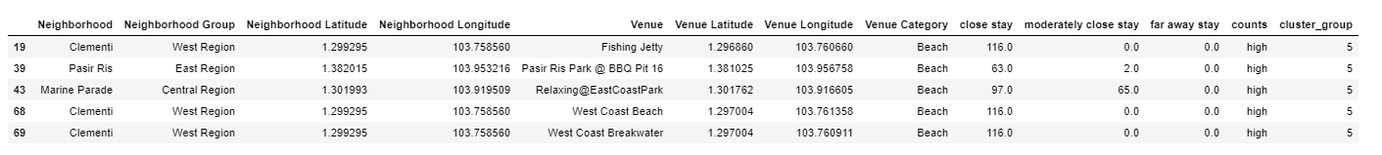
Results: Cluster 5

Slide 18
Conclusion:
From the results, it can be seen that each cluster has some unique property such as some might be best suitable for a particular type of Venue category.
Some others might be better just because it has a high number of Airbnb rental listings.
As an example, if a traveller is looking for places that has the best trail, it can be suggested to go for the Neighbourhoods in Cluster 0 which has relatively more Trail venues and an average number of Airbnb listings.
For travellers, who prefer beach venues, Cluster 5 can be suggested as it has an high no of Airbnb listings close to those venues.
Hence Travel agents can create specific itineraries which might suggest the best places to visit for travellers based on their needs and also based on the number of Airbnb listings.

